Slide 1
AMEND AN EVENT
UPDATED FEBRUARY 3, 2021

Slide 2
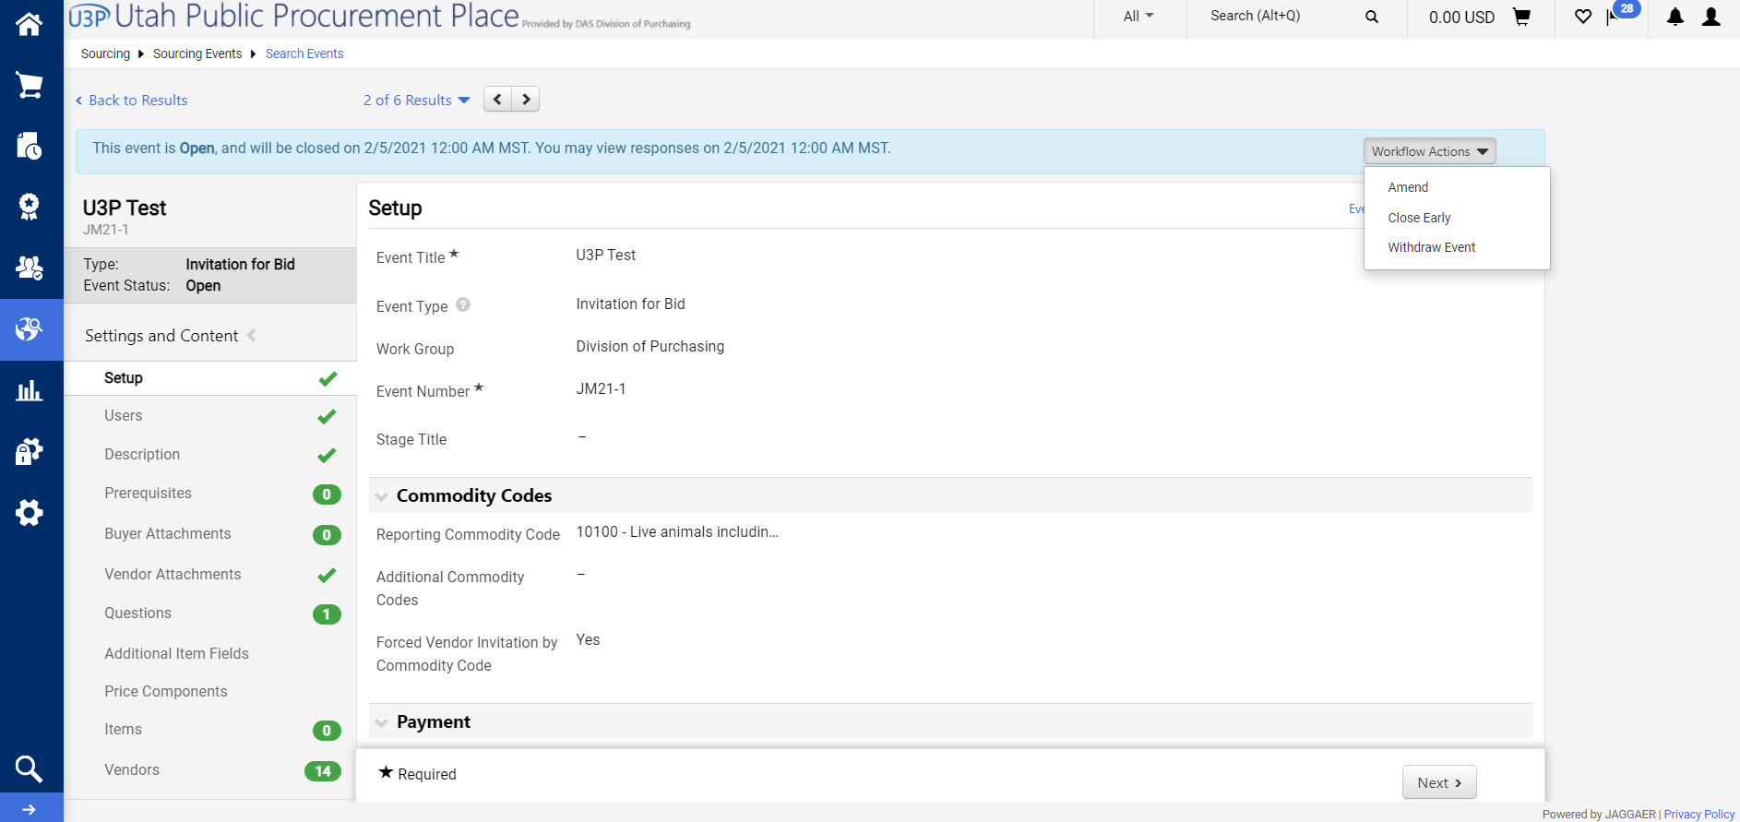
Step 1
Go inside your event, select the “Workflow Actions” dropdown, then select “Amend”.

Slide 3
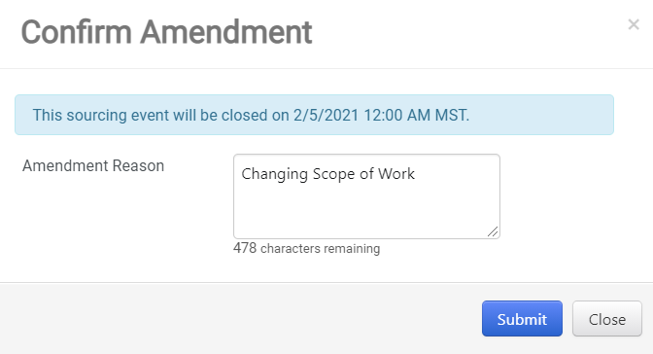
Step 2
“Confirm Amendment” pop up will appear.
Enter a reason for the amendment.
Select “Submit”.

Slide 4
Step 3
You will then be able to make any necessary changes to your event.
(Examples include: Upload revised document, change scope of work, or updating a description.)
Vendors will receive a notification that the event is being amended.
While you are amending your event, vendors will not be able to submit their responses.
Please Be Aware
Amending an event will “kick out” any completed vendor submissions. This means the vendor will have to log in to their account and hit the “Submit” button again after they have made any applicable changes.
The system forces vendor submissions out to ensure that they are aware of the amendment and can make any applicable changes to their proposal.
Vendors will not have to answer any questions again or re-upload documents they have not revised.

Slide 5
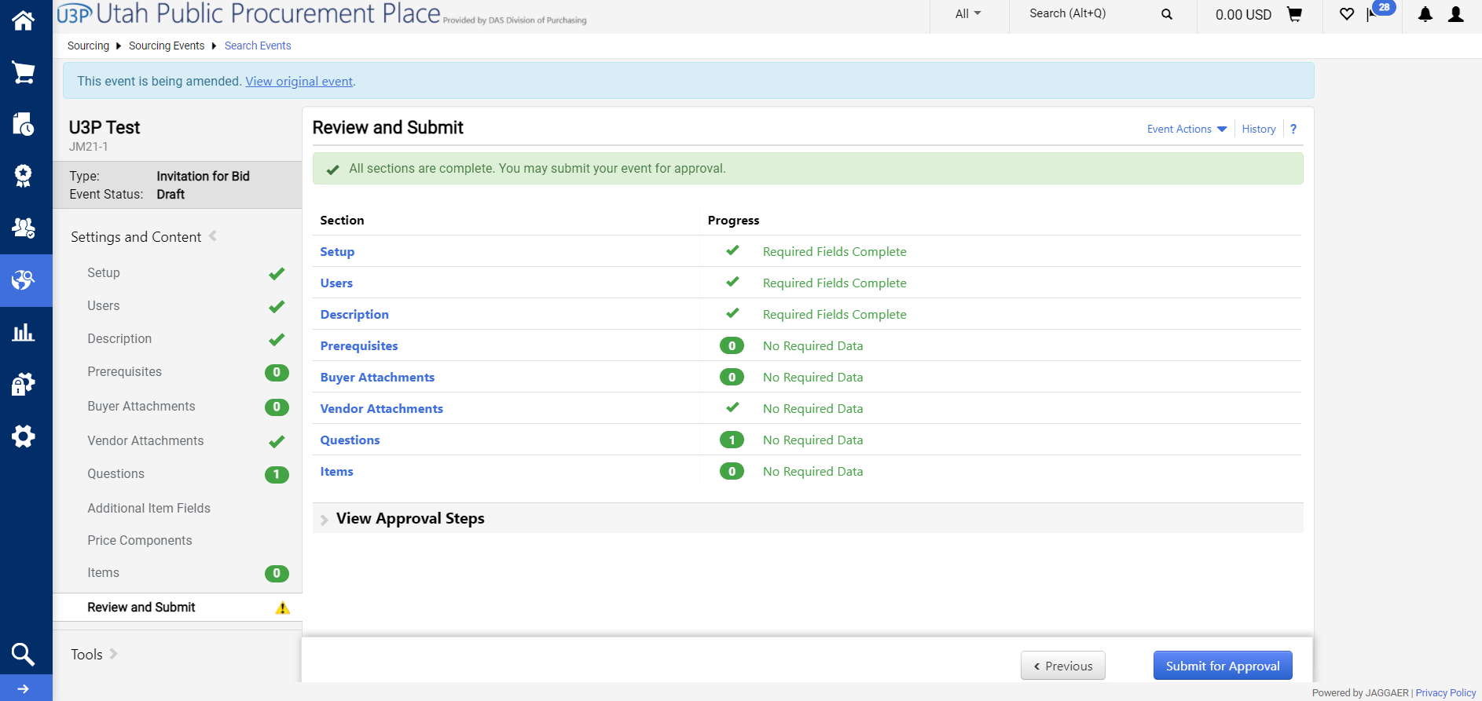
Step 4
You will see your event is being amended in the top left.
When finished, select review and submit on the left side menu.
Then select “Submit for Approval” on the bottom right.

Slide 6
Step 5
Select the “Workflow Actions” drop down menu and select “Approve”.
The top left will show that your event has been amended.

