Slide 1
Professional Association Dues and Fees, Sponsoring, & Training Procurements

Slide 2
Definitions
Award: formally notifying the vendor or supplier that their quote has been selected and the purchase will be made through them
Chief Procurement Officer (CPO): the director of the Utah Division of Purchasing who holds the procurement authority for state agencies
Procurement: the acquisition of a procurement item through an expenditure of public funds, or an agreement to expend public funds
Procurement item: an item of personal property (goods), a technology, a service, or a construction project
State Purchasing: the Department of Government Operations, Division of Purchasing and General Services
State Agency: an executive branch agency that does not have independent procurement authority and falls under the jurisdiction of State Purchasing.

Slide 3
Purpose
To provide insights or processes for purchasing:
Group gathering & retirement refreshments
Professional association dues and fees
Sponsorship
Conference registration
Speakers, presenters, or trainer

Slide 4
Before Any Purchase
If the desired procurement item is available through one of the sources listed below, a State Agency must purchase from that source. A State Agency cannot choose use a small purchase through another source, when the procurement item is available through one of these sources.
• Mandatory Use Agencies
(State Fleet, State Travel, UCI, State Mail, DTS, Risk)
• Agency Contract
• State Cooperative Contracts

Slide 5
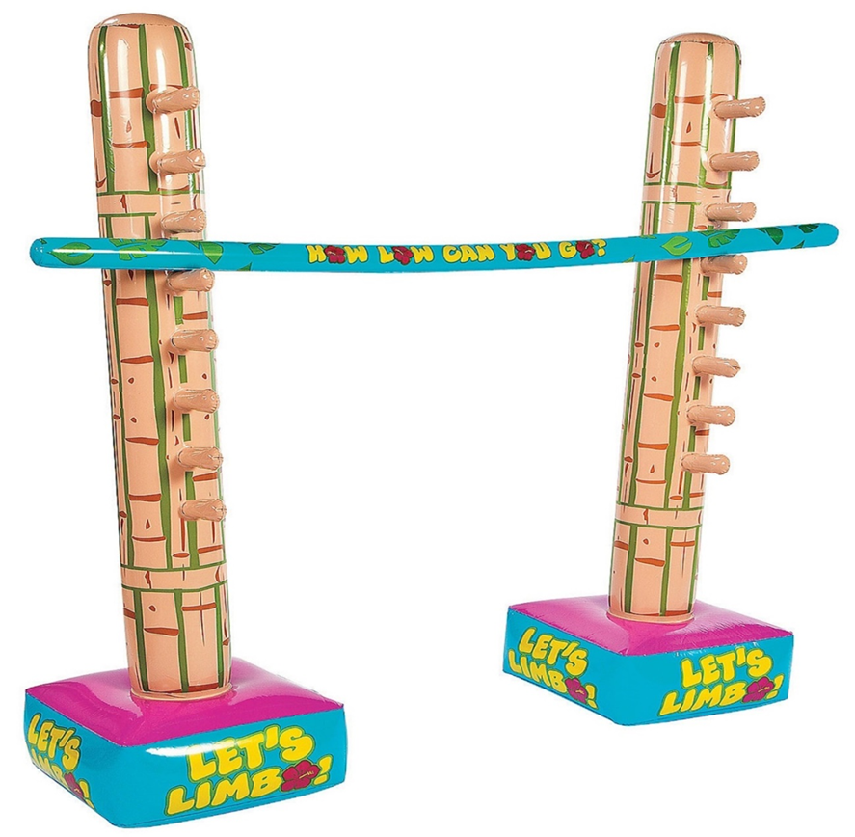
Small Purchase Spending Limit
$10,000 limit per purchase
The $10,000 limit per purchase:
is true for all state agencies that do not have independent procurement authority; and
applies to both the standard small purchase process and the quotes for small purchases process
State Agency
UCA 63G-6a-506; Section R33-105-102; R33-105-103

Slide 6
Small Purchase
(no-quotes required)
$5,000 limit per purchase
Every items must be $5,000 or less
State Agency
When the highest priced item being purchased is $5,000 or less in cost AND when the total purchase price does not exceed $10,000, the state agency may select the best source by direct award without seeking competitive bids or quotes.
Section R33-105-102

Slide 7
Quotes for Small Purchases
$10,000 limit per purchase
An individual item exceeds $5,000
State Agency
When completing a quotes for small purchases solicitation process, the procurement unit:
(a) shall determine the minimum specifications for award including a vendor response due date and time;
(b) shall provide the minimum specifications to multiple vendors;
(c) shall obtain a minimum of two competitive quotes which include minimum specifications; and
(d) shall purchase from the responsible vendor offering the lowest quote that meets the specifications
Subsection R33-105-103(2)

Slide 8
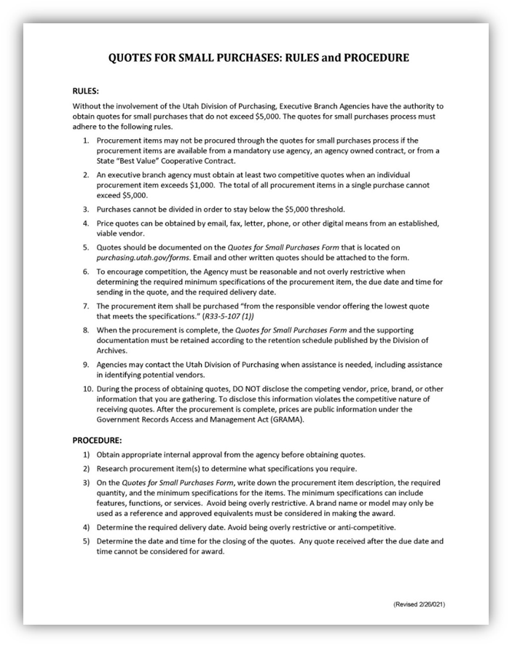
Quotes Form
The Quotes for Small Purchases Form located in the Solicitations Forms tab on purchasing.utah.gov/forms/ contains the procedure to legally obtain quotes.
Download and review the form for information concerning:
Confidentiality during the quote process
Establishing a quote closing date and time
Providing the same information to all vendors
Use of digital quotes
And more

Slide 9
WARNING - Send to State Purchasing
When the purchase is anticipated to exceed $10,000
Quotes must be collected by State Purchasing
If the state agency collects the quotes and learns the purchase will exceed $10,000, do not award.
Contact your agency finance team to enter an request for solicitation (RQS) or request for a master agreement (RQM) in FINET
STOP
Limit Exceeded
Email all solicitation documents to purchasingsolicitations@utah.gov with the subject of the email is the complete RQS or RQM number

Slide 10
Group Gatherings & Retirements

Slide 11
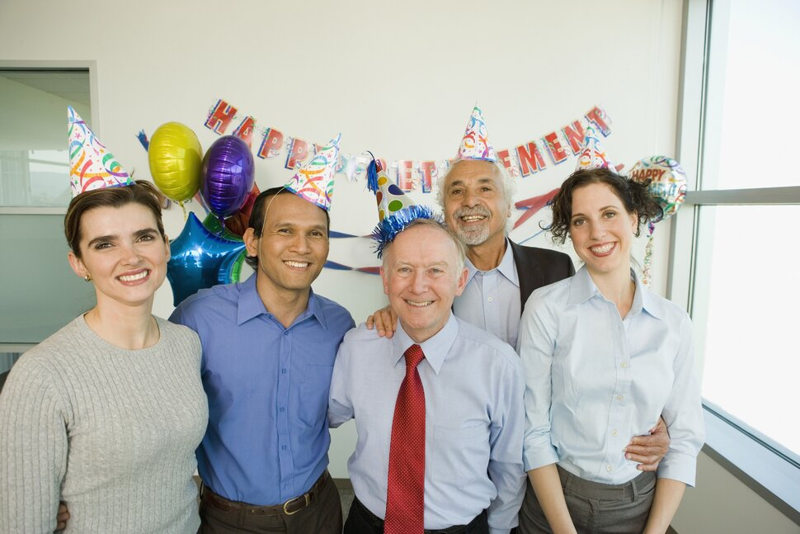
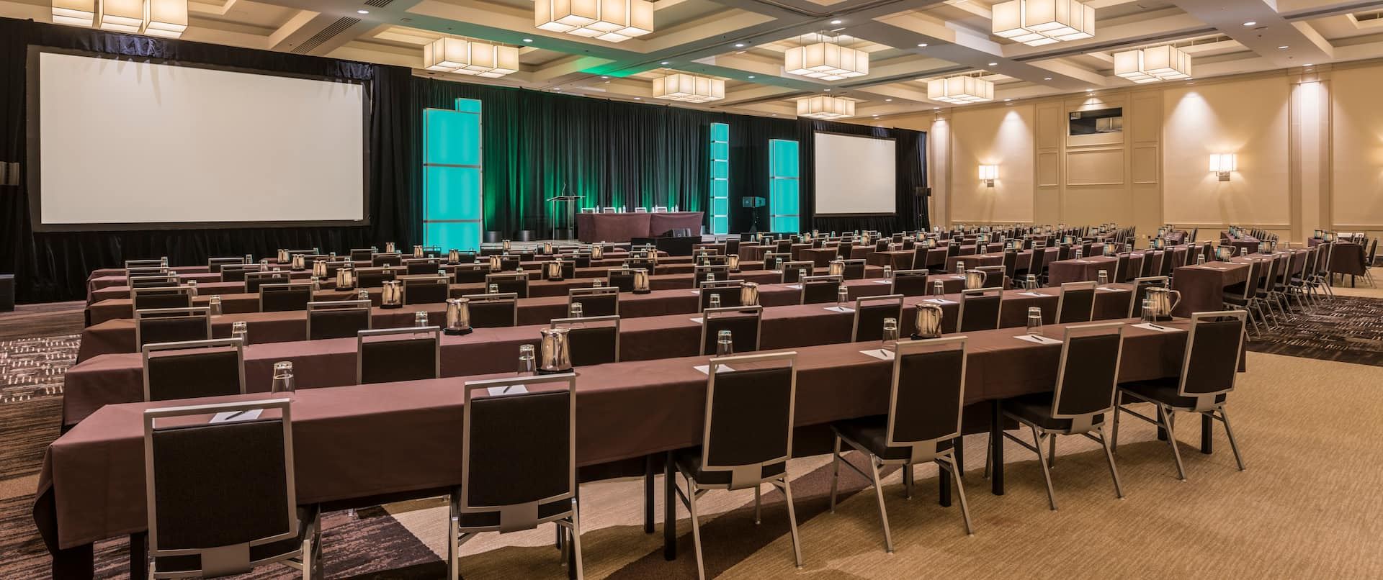
GROUP GATAHERINGS
For state funded group gatherings, the state agency must review and abide by the Finance Policies appropriate to the gathering:
• Group Gathering Policy (FIACCT 10-04)
• Retirement Refreshments (FIACCT 05-03_10)
• All policies pertaining to Travel (FIACCT 10 series)

Slide 12
Professional Association Membership Dues and Fees
For Employee or State Agency

Slide 13
Professional Association Membership Dues and Fees
The Chief Procurement Office has determined that professional association membership dues and fees do not require a procurement.
HOWEVER, State Finance Policy FINCCT 05-08_00 policy does govern the approvals required prior to purchase.

Slide 14
Sponsorships

Slide 15
Sponsoring Event or Conference [Policy PURCH-03]
A sponsorship of an event or conference is not a procurement item and does not require a procurement process. Sponsorship payments are generally made directly to the event or conference and should reference the State Purchasing policy PURCH-03.
Questions about payments to vendors, trainers, or service providers for conference related services should be directed to State Purchasing prior to procurement or award.
Purchasing a booth space is not a sponsorship even if the conference claims it as such.
The Chief Procurement Officer has the final authority to determine whether or not a payment qualifies as a sponsorship.

Slide 16
Training Procurement Questions

Slide 17
Training Procurement Questions
Refer to the following slides to determine the correct procurement process for training purchases.
Key Points to Remember
Agency internal approvals must be obtained.
Travel must be arranged through State Travel.
Conference fees are generally paid by P-Card.
Address questions to State Purchasing before action is taken.

Slide 18
Training Procurement Questions
Question 1:
Is the requested training considered tuition?
Yes. Follow the state agency’s tuition reimbursement policy
No. Move to the next slide

Slide 19
Training Procurement Questions
Question 2:
Is the training a professional or trade certification or re-certification required to obtain knowledge, experience, and skills to perform the job or tasks associated with the employee’s CURRENT position?
Yes. The training falls under State Purchasing Policy PURCH-03 “Items that do not require procurement.” Make payment and reference the policy. If there is a question concerning the training qualifying under the Policy, Chief Procurement Officer makes the final determination.
No. Move to the next slide

Slide 20
Training Procurement Questions
Question 3:
Is the training expense for “Conference fees sponsored by the Federal Government, a UtahGovernment Agency, or a Professional Associations”?
Yes. The training falls under State Purchasing Policy PURCH-3 “Items That Do Not Require Procurement.” Make payment and reference the policy. If there is a question concerning the training qualifying under the Policy, Chief Procurement Officer, makes the final determination.
No. Move to the next slide

Slide 21
Training Procurement Questions
Question 4:
Is the State Agency hosting a meeting or conference?
Yes. Follow State Finance FIACCT 10-04.00 Group Gathering Policy for food, travel, parking, venue, and audio/visual equipment. Presenter costs are separate from the Group Gathering. For presenter costs, go to the “Speaker, Presenter, or Trainer” section for further information.
No. Move to the next slide

Slide 22
Training Procurement Questions
Question 5:
Is the State Agency hiring a presenter, speaker, or trainer?
Yes. Proceed to the “Speaker, Presenter, or Trainer” section of this training for further information
No. Move to the next slide

Slide 23
Training Procurement Questions
Question 6:
Are you attending an outside conference or training not previously defined?
Yes. Proceed to the “Conference Registration Fee” section
No. Move to the next slide

Slide 24
Training Procurement Questions
For training procurement not defined by the previous questions or for any additional assistance please reach out to State Purchasing at 801-957-7160.

Slide 25
Conference Registration

Slide 26
Conference Registration Fees
Conference registration fee means any fee paid to the conference at the time of registration. The fee can include required supplies or activity costs.
Internal approvals must be completed prior to registration for the conference.
All travel registrations and expenses must be completed according to State Travel Policy.
Registration

Slide 27
Conference Registration Fees
Registration fee for 1 individual is $5,000 or less
Registration fee is $10,000 or less for all attending employees
Agency uses the Small Purchase Process (No-Quotes Required)
Documentation must show the cost per person when more than one individual is attending

Slide 28
Conference Registration Fees
Registration fee for 1 individual is $5,000 or less
Registration fee is more than $10,000 for all attending employees
Must be submitted to State Purchasing by entering an RQS in FINET
Submit to State Purchasing for a Quotes for Small Purchases or a Sole Source (ACWESPP), if justifiable

Slide 29
Conference Registration Fees
Registration fee for 1 individual exceeds $5,000
Registration fee is $10,000 or less for all attending employees
Agency can complete a Quotes for Small Purchases Process OR
Submit to State Purchasing for Quotes for Small Purchases or a Sole Source (ACWESPP), If justifiable

Slide 30
Conference Registration Fees
Registration fee for 1 individual exceeds $5,000
Registration fee is more than $10,000 for all attending employees
Must be submitted to State Purchasing by entering RQS in FINET
State Purchasing will complete a Quotes for Small Purchases or a Sole Source (ACWESPP), if justifiable

Slide 31
Speaker, Presenter, or Trainer

Slide 32
Speaker, Presenter, or Trainer
The cost associated with hiring a speaker, presenter, or a trainer can be divided into the two categories below.
Speaker Fees
Presentation Cost or Honorarium
Development costs, optional
Supplies, optional
Travel Costs
Airline Ticket
Car Rental
Hotel
Milage
Meals
Vendors will quote payment in one of two ways: Speaker Fee plus Travel Reimbursements or Lump Sum Speaking Fee. In either case, when the speaking fees will exceed $5,000, the solicitation must be sent to State Purchasing for Processing before engaging a speaker/presenter.

Slide 33
Determine Payment to Apply to Procurement
Speaker Fee plus Travel
Reimbursement
B. Lump Sum Speaking Fee
(Travel not reimbursed)
Speaker fee is limited to the cost for presenting
State agency books travel through State Travel (CB Travel Contract) for “non-state employees where the state is paying for their travel” (FIACCT 10-02.00 Item F)
Travel reimbursement according to State Travel Policy
When the industry requires the traveler to pay the bill, such as car rental or hotel bill, the reimbursement should include the CB Travel reservation documents
Presenting or Speaking Fee is flat lump fee that will “cover” the cost of travel because:
Vendor requests to make own travel arrangements, or
State agency chooses a lump sum payment in lieu of paying individual travel expenses
Vendor books own travel through their own travel vendor (FIACCT 10-02.00 Item F)
Travel expenses cannot be reimbursed as they were included in the lump sum presenting or speaking fee

Slide 34
A. Speaker Fee plus Travel Reimbursement
Speaking Fee does not exceed $5,000
Travel Expenses are paid directly by the state agency and must follow State Travel Policy
Agency competes the Small Purchase Process (No-quote required)
Agency must use Travel Policy for travel using the Concur program and the cooperative contract CB Travel Corporation (AR1459) to book travel
When the industry standard requires the car rental or hotel bill be paid by the user, reimbursement can be made for the vendor’s expense with itemized receipts

Slide 35
B. Lump Sum Speaking Fee (Travel not reimbursed)
Presenting or Speaking Fee is one lump fee that will “cover” the cost of travel
The total payment does NOT exceed $1,000
Agency competes the Small Purchase Process (No-quote required)
Agency MUST book travel on their own; cannot use the State Travel contracts
Vendor MAY NOT request reimbursement for travel receipts as those costs were included in the lump sum speaking fee

Slide 36
Speaking Fee Exceeding $5,000
Speaking Fee exceeds $5,000 whether travel is reimbursed or in the lump sum
Must be submitted to State Purchasing by entering RQS in FINET
State Purchasing will discuss speaker fees and travel with the agency. State Purchasing will then complete the appropriate solicitation process

