Slide 1
EXTEND AN EVENT
UPDATED FEBRUARY 3, 2021

Slide 2
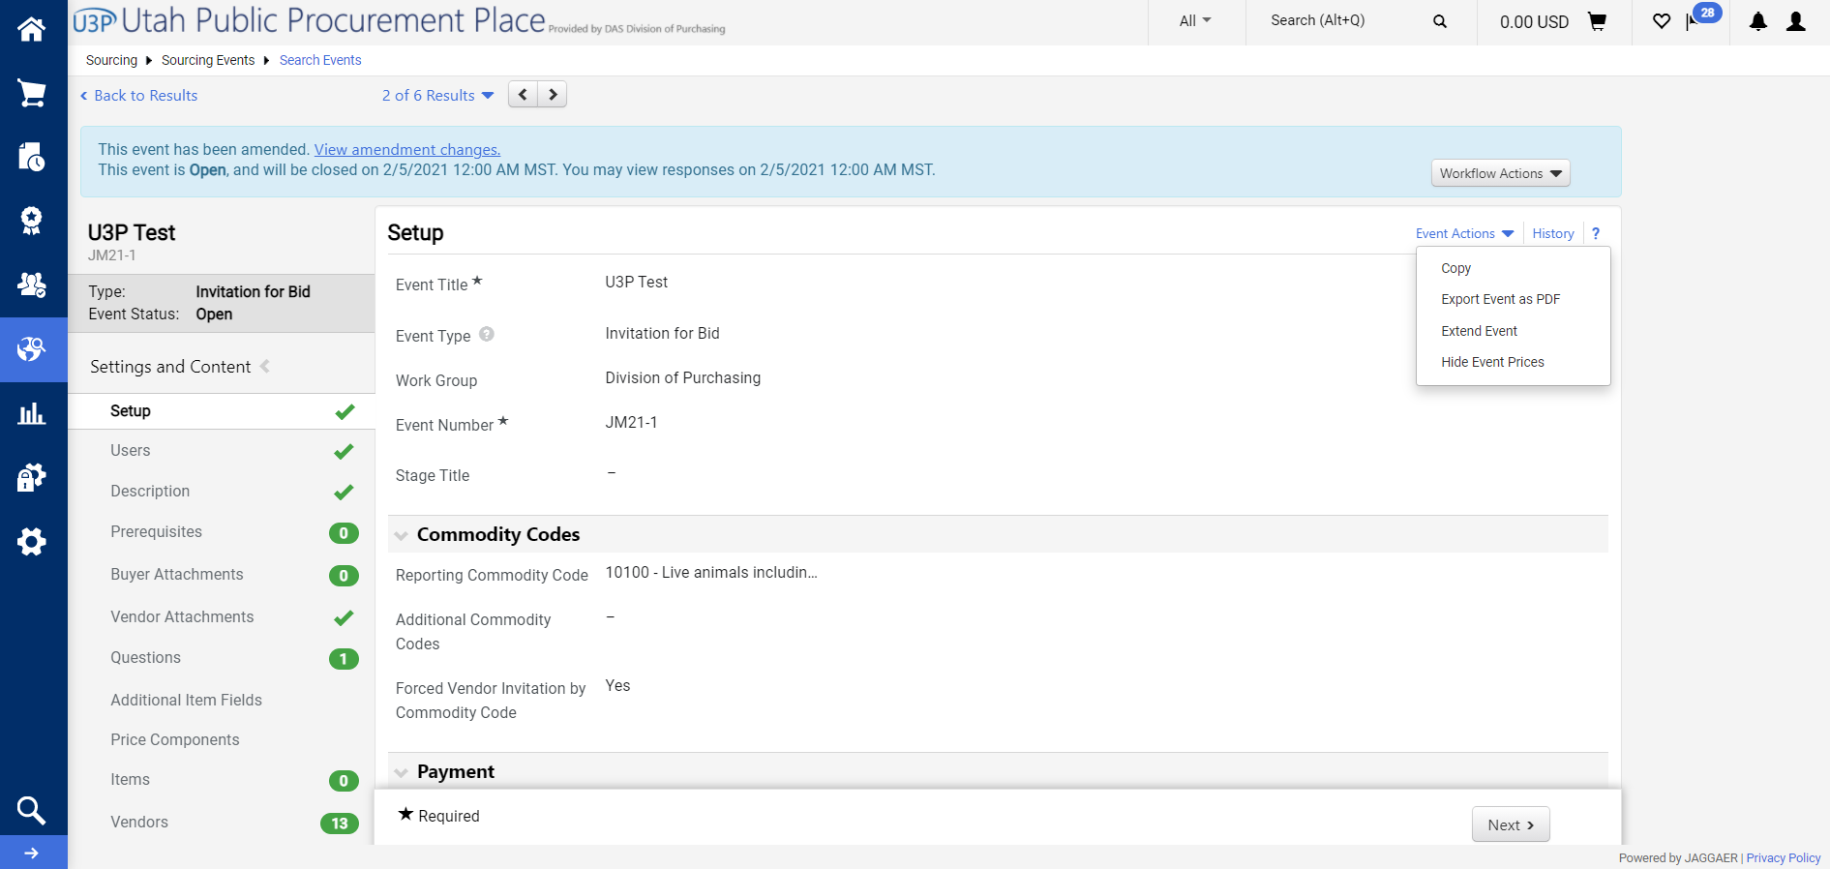
Step 1
Open up the event you intend to extend.
Select the “Event Actions” drop down menu and select “Extend Event”.

Slide 3
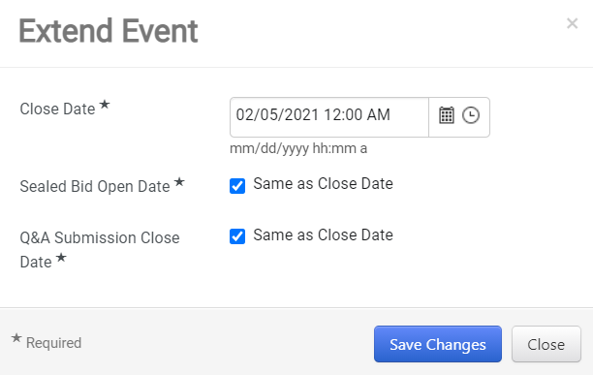
Step 2
An “Extend Event” pop up window appears with the option to change the following:
Close Date: You may change the close date and time.
Seal Bid Open Date: You may select to edit the date and time or make it the same as the close date for the event. (Only available if your event is configured to use seal bids.
Q and A Submission Close Date: You may change the Q and A close date and time or make it the same as the close date for the event.
Save Changes.

Slide 4
Notes
The updates of the extended event will be reflected inside the event.
Extending an event will NOT “kick out” any completed vendor submissions.

