Slide 1
State Cooperative Contracts
Rev 01-2025
Making a Best Value Decision

Slide 2
The Division of Purchasing has completed the solicitation and contracting work to the state cooperative contracts (SCC) in place.
You reap the benefits.

Slide 3
Benefits of State Cooperative Contracts
Saves time on reoccurring solicitation for identical procurement items
Reduces staffing expense for public entities
Provides protection against procurement fraud

Slide 4
State Cooperative Contracts Can Provide
Lower prices with collective purchasing power
Higher quality goods/services
Stronger contract terms and conditions
Better maintenance/service
Improved delivery terms

Slide 5
State Cooperative Contracts are contained in portfolios which usually offer multiple contracts for the same types of items or services.
Which contract should you use?

Slide 6
First, read the ordering instructions on the contract’s landing page.
What do the instructions say must be done to make a purchase?

Slide 7
If ordering instructions state a quote or another secondary solicitation is required, you will have to get a quote or complete the required secondary solicitation process.
Award according to the ordering instructions.
R
F
Q
Request for Quotation

Slide 8
If the ordering instructions do not state that a secondary solicitation process is required, then the end user makes a best value decision.
Most State Cooperative Contracts allow the end user to make a best value decision.
Best Value
Decision

Slide 9
A best value decision is a purchasing method that considers factors beyond cost of the items being purchased.
Best Value
Decision

Slide 10
Consider the Contract Terms
Price
Quality
Terms and conditions
Maintenance agreement
Delivery costs
Shipping speed
Warranty
Mileage fees (service contracts)
Contractor performance

Slide 11
For each purchase, a public entity must weigh and balance the price, quality, and other terms of the contracts in the portfolio to determine which contract is the best value for the situation.

Slide 12
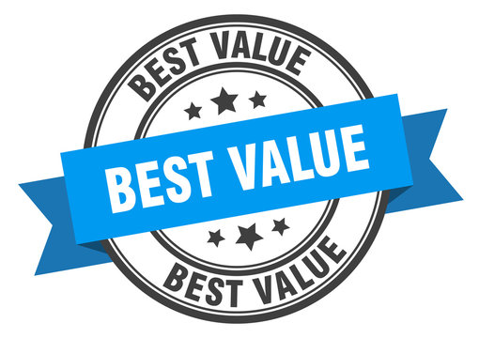
Keep in mind:
a Best Value Decision
Is not always the lowest price
Is different for each public entity
Is based on a review of the price, quality of the product, and terms of the contract

Slide 13
Thank you
801-957-7160
purchasingcontracts@Utah.gov

