Slide 1
State Cooperative Contracts (SCC)
Rev 01-2025
How to Buy

Slide 2
Step 1
Finding an Item on SCC

Slide 3
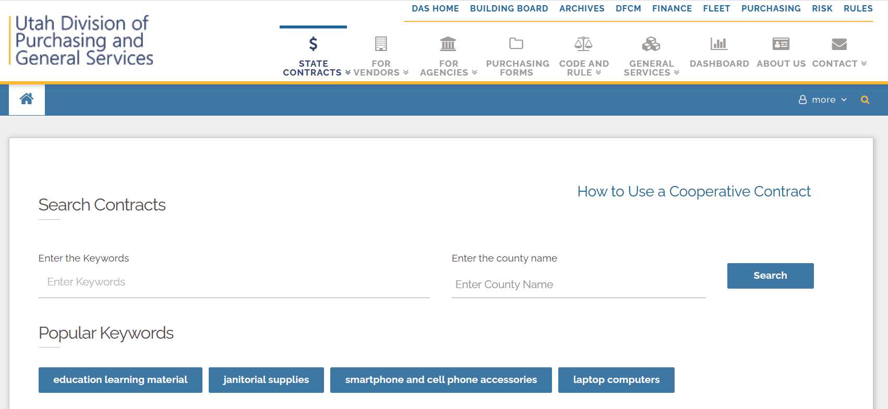
Location of SCC Search Engine
statecontracts.utah.gov

Slide 4
New User? “How to Use a Cooperative Contract” PDF
Download the “How to Use a Cooperative Contract” PDF which provides the best practices for using state cooperative contracts

Slide 5
Search for contracts using keywords:
Contract Number
Vendor Name
Item desired
Portfolio or Contract Family name

Slide 6
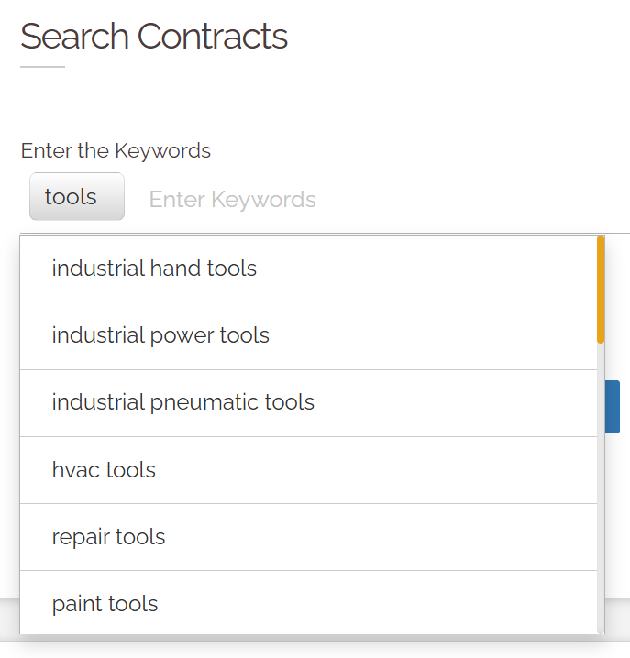
Enter your first keyword and WAIT
The system will provide a list of options
Click on one of the options
You can use the orange slider to see more options

Slide 7
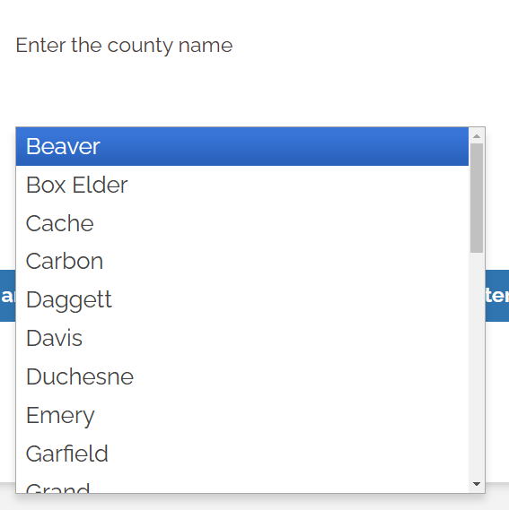
Reside outside the Wasatch Front?
Enter the county name to limit the contracts to those available in your county

Slide 8
If you cannot find a contract,
call 801-957-7160 to be directed to a purchasing agent or email purchasingcontracts@utah.gov
If a contract needs new keywords, email the Contract Manager

Slide 9
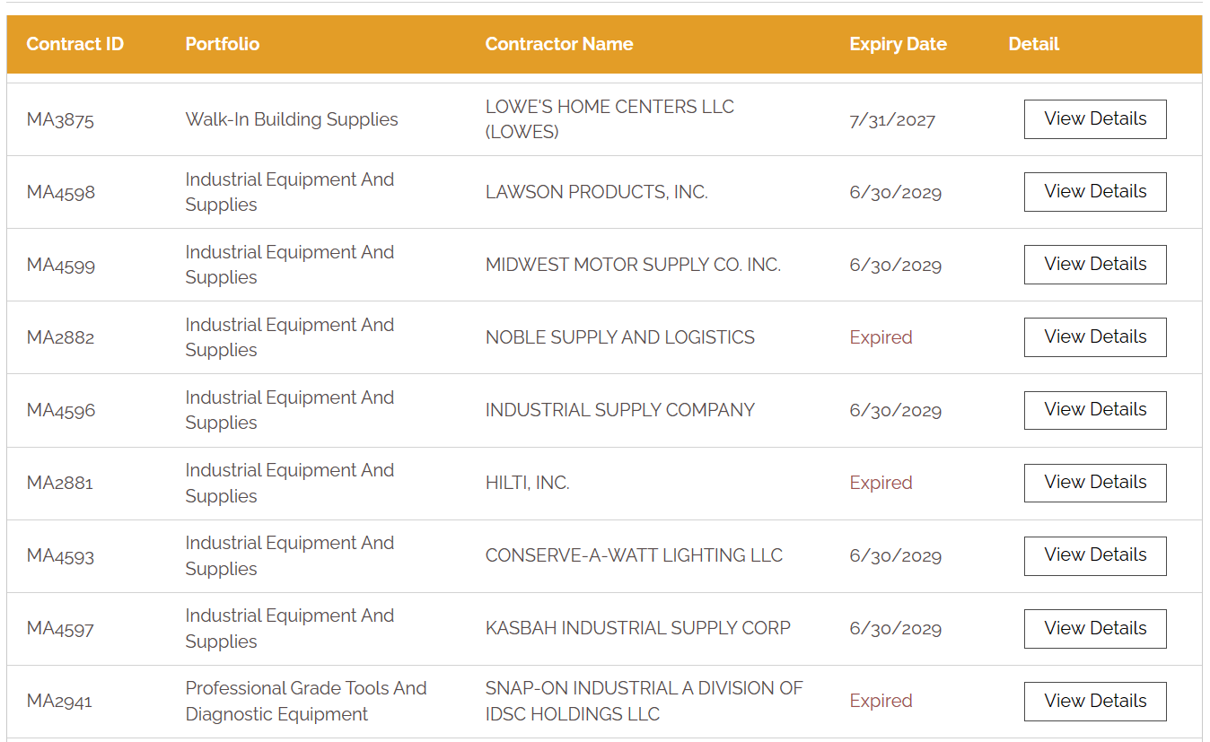
All contracts with the keywords will be displayed in a random order. By randomizing, the contractors have the same opportunity to be seen.

Slide 10
Multiple contracts will appear in the “Search Results.”
Similar contracts are in the same Portfolio

Slide 11
Click on the headers to sort the contracts by contract ID, portfolio name, OR contractor name
A second click on the same title will reverse the order

Slide 12
When there are more results than fit the page, use the icons to navigate to subsequent pages

Slide 13
Watch the expiration date
Do not buy from expired contracts
Expired or canceled contracts will appear on the list for 18 months for audit purposes

Slide 14
Select a contract to review by clicking “View Details”
You will be taken to the contract landing pad

Slide 15
Contract Landing Page: Defined
Contractor Details | Contractor’s contract manager contact information & website
Portfolio of Contract | The name of the group of contracts. The contracts in the contracting family should be reviewed to determine best value
Ordering Instructions | Instructions specific
Contract Details | Provides the full contract for review of terms and conditions, scope of work, and specifics about pricing
Additional Details | Review any information that may be provided in this optional field
Questions or Concerns | State Purchasing’s Contract Manager who can answer questions
Related Contracts | Contracts in the same portfolio to review to determine best value
Other Contracts | Contacts by the same vendor

Slide 16
Step 2
Making a Purchase

Slide 17
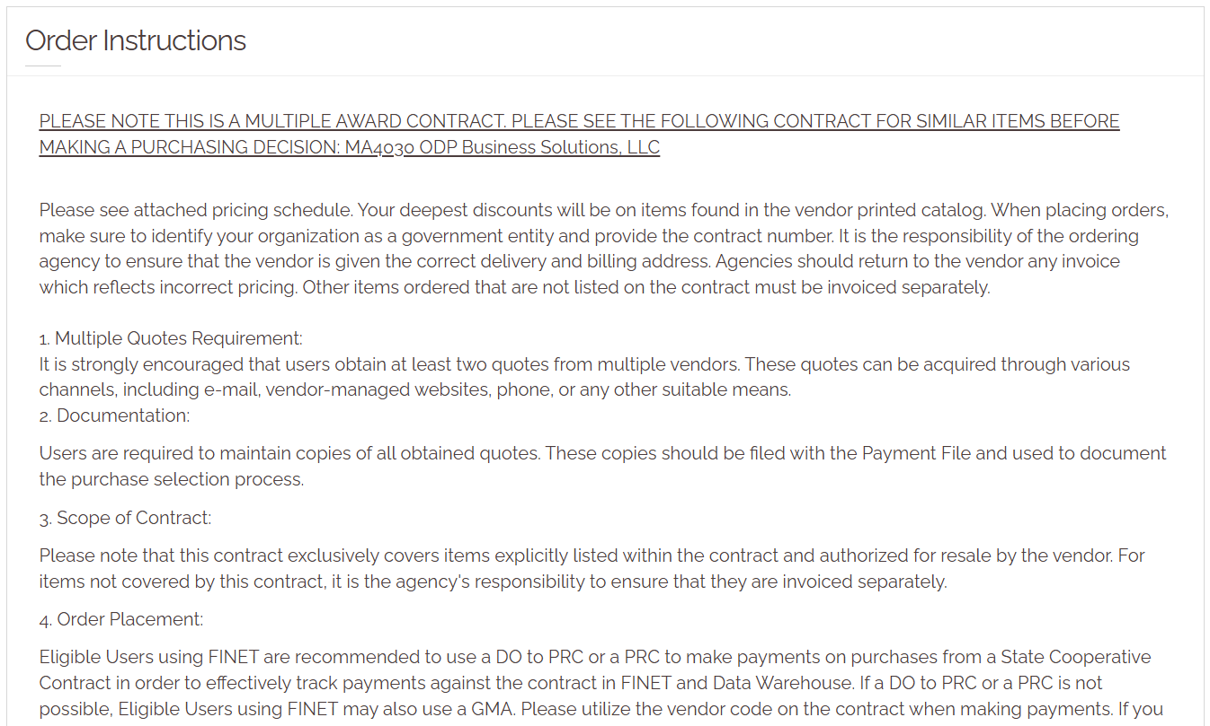
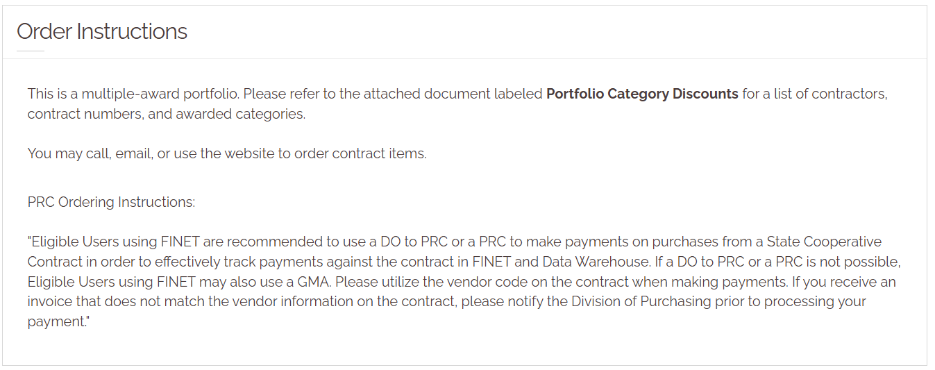
Review Ordering Instructions
How to order
Complete any steps required
If no secondary solicitation is required, make a best value decision from which contract in the portfolio to buy*
*See the slide deck SCC: Making a Best Value Decision for more information

Slide 18
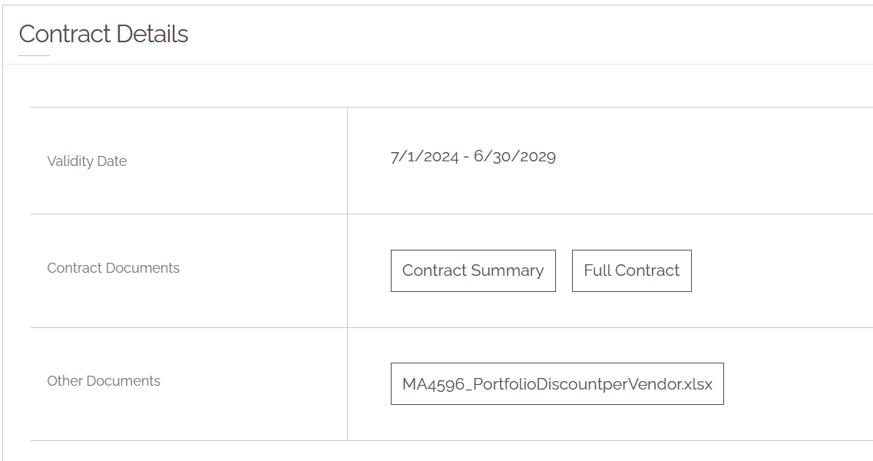
Contract Details
Review the full contract’s scope of work to see what can be purchased from the contract
Review pricing
See if a document lists categories by which the contractor must abide
Only purchase items listed on the contract or in a category allowed to be sold through the contract

Slide 19
Working with the Contractor
Place your order by phone, email, or website (if available)
Provide the contractor the contract number
With every purchase, ask about the price! Ensure the contract pricing is given
If ordering from a website, make sure that the contractor created a user name for you which connects you to contract pricing

Slide 20
801-957-7160
purchasingcontracts@Utah.gov

