Slide 1
Scope of Work Where to Begin

Slide 2
Where to Begin
We recommend downloading the “Scope of Work Template” from the Division of Purchasing website, you can find it here.
It’s a great tool that can be used all on it’s own.
When used in conjunction with these slides you should have everything that you need.
Note: These slides refer to scope of work and specifications interchangeably. Consider them the same thing for purposes of drafting what you need to draft.

Slide 3
Writing Specifications – Let’s be Clear
Specifications should be written clearly, concisely, consistently, and precisely, using plain language.
Don’t use big fancy words, you are not trying to impress a college professor.
Avoid run-on sentences and use proper grammar.
Break the cycle! It doesn’t need to “sound official” with legalese or bureaucratic language.
Say it once – repeating information in a solicitation inherently invites ambiguity.
Minimize multiple interpretations

Slide 4
Plain Language – Less Words Less Confusion
Before: “When the process of freeing a vehicle that has been stuck results in ruts or holes, the operator will fill the rut or hole created by such activity before removing the vehicle from the immediate area.”
After: “If you make a hole while freeing a stuck vehicle, you must fill the hole before you drive away.”

Slide 5
Steps for Developing Specifications
Meet with end users, stakeholders, evaluation committee, etc. to understand needs. Get other people to buy in and then they can’t complain later!
Consider conducting an RFI. Get feedback from the market players on what’s out there.
Conduct research (we can help → ProcurementIQ, GovWIN)
Conduct a business analysis to help identify what you really need. It’s not just about the procurement item, your current business practices may need to change too.
Use the type of specification (functional, performance, design) that makes sense for your needs.
Have your specifications reviewed by someone else. You think you are being clear but… you aren’t.
Focus on accurately describing the need/purpose of your specifications and solicitation.
Don’t create arbitrary requirements (especially in a re-solicitation, make sure it’s relevant!)
When appropriate leverage vendor expertise and allow for multiple solutions.

Slide 6
Bad Specifics Undermine the Purpose of the Procurement Code
Have you ever had a vendor who gets frustrated reading your solicitation? Venting in the Q&A Board?
Bad specifications can result in vendors who read the specifications and think “well they just want so and so to win this…” or “that’s obviously written for so and so” and they may not respond or take a lot less time than they normally would to respond.
Don’t just repeat what has been before. Our job isn’t to ensure the same contractor jumps through the hoops every 5 years to get their next 5 year contract.
Protests!? Don’t write specs that are so bad you get officially and administratively called out for it in writing.

Slide 7
Good Specifications Promote Competition
Well-written specifications allow suppliers to easily read and understand what is needed. Specifications should encourage suppliers to respond and maximize competition.
More responses = good. This increases the likelihood an agency will get a procurement item that achieves the objectives of the procurement.
Put yourself in the vendors shoes. Don’t hide the ball and think about how your specifications can be perceived.
Everything should be done to promote fair competition, not geared towards getting a specific item or vendor.
Keep the purpose of the Procurement Code close to your heart! <3

Slide 8
Specifications – Purpose
Promote overall economy
Best use for purposes intended
Encourage Competition
Cannot be unduly restrictive
UCA 63G-6a-111

Slide 9
Specifications – What are they?
Describing physical or functional characteristics or nature of a procurement item
Can include requirement for testing/inspecting item or preparing an item for delivery (63G-6a-103(86))
Types of Specifications (may be combined)
Functional
Performance
Design (Technical)

Slide 10
Functional Specifications
Defines function, duty or role of the procurement item.
Focuses on what is to be achieved, not how it is done.
Does not describe method of achieving result, which enables suppliers to provide innovative solutions to defined problems.
Example:
We need to transport children from school to their homes.

Slide 11
Performance Specifications
Natural extension of functional, focusing on performance metrics
Defines procurement item in terms of how effectively it will perform
Defines the task or desired result by focusing on what is to be achieved
Like functional specifications, does not describe method of achievement
Example:
We need a device capable of transporting at least 30 children every afternoon of the school week from their school in a safe manner to their homes within a 5 mile radius of the school. Device must be capable of achieving this within 1 hour. Must provide children with a comfortable environment of an average of 72 degrees Fahrenheit in all weather.

Slide 12
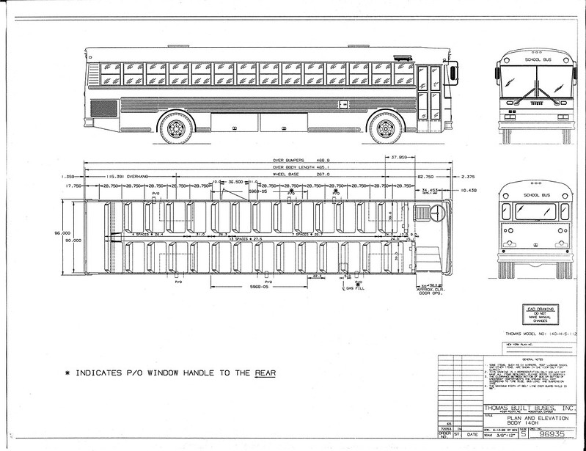
Design (Technical) Specifications
Defines physical characteristics, processes, etc. of a procurement item
Describes the “how” or method to be used (defined terms, drawings, etc.)
Only used when Functional or Performance Specifications are insufficient
Example:
We need this ->->

Slide 13
Types of Specifications (wrap up)
The type of specifications you use will vary depending on the solicitation.
They will often combine/flow into each other and that’s okay.
Try not to be too prescriptive, unless it’s really required to ensure your needs are met.
Always remember the purpose of the code/specifications and pick specifications that will promote competition, best use, etc.

Slide 14
Using Brand Names in Specs
Why use a brand name in a specification?
Pros
Standardization within an organization (we all have air pods)
Meets expectations
Easier to write specifications
Cons
More restrictive, potential to limit competition and innovation
You get the same thing you always have (is it really the best fit for your needs?)
Create dependency with certain product or supplier (future sole source incoming)

Slide 15
Brand Names in Specs - How
What do your specifications need to include if you use a brand name?
TWO Key Requirements when using brand names in specifications:
“Or equivalent” reference included; AND
As many other brand names as practicable are also included. (R33-4-103(4)

Slide 16
Brand Name or Equivalent
“Or equivalent” really means equivalent, you can’t guarantee what you get.
Equivalency is based on functionality and performance (not identical)
The Court of Claims has specifically rejected the Government defense that it is entitled to get exactly what it specifies. The substitute does not have to comply with every detail of the specification, but only function as well as the specified product. Aerodex, Inc. v. United States, 417 F.2d 1361 (Ct.Cl.1969); Jack Stone Co. v. United States, 344 F.2d 370 (Ct.Cl.1965). See also Ocean Elec. Corp., NASA BCA No. 371-8, 73-2 BCA p 10,355.

Slide 17
Brand Names in Specs – Other Things to Know
You need to give your specifications enough meat to help vendors.
The brand name/manufacturer specifications must include minimum acceptable requirements of an equivalent.
“Equivalent” items should be easily deduced from the face of your solicitation.
Define/spell out proprietary terms

Slide 18
Thanks! - Resources
NASPO State and Local Government Procurement: A Practical Guide.
NIGP Public Procurement Practice – Specifications
The University of Queensland – Specification Writing Guide
https://imgflip.com/memegenerator/28829275/holy-batman

