Slide 1
SETTING UP YOUR SCIQUEST ACCOUNT
UPDATED FEBRUARY 4, 2021

Slide 2
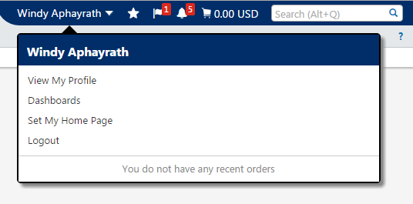
CHANGING YOUR PASSWORD
Step 1: Go to the top right of the screen, you will see your name. Click on the small white down arrow beside your name.
Step 2: Click on View My Profile

Slide 3
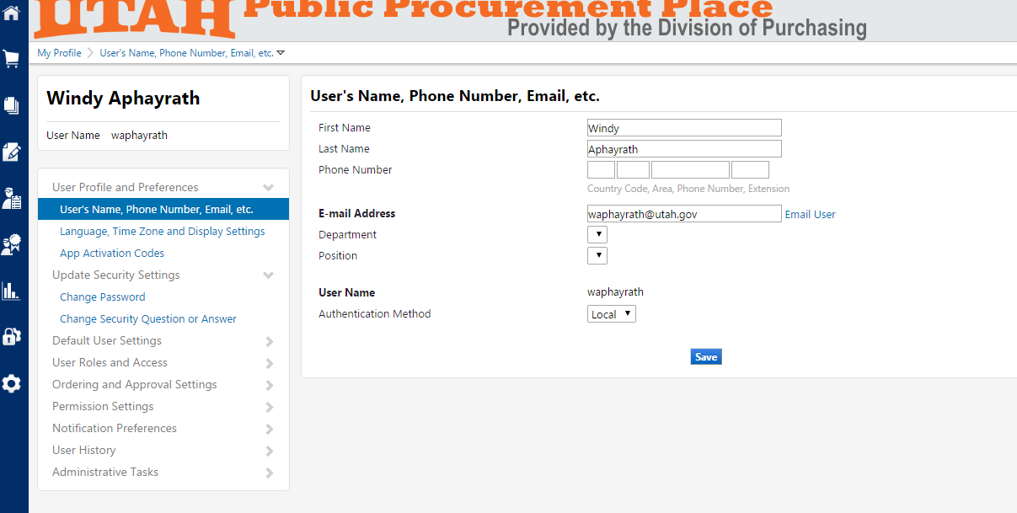
CHANGING YOUR PASSWORD
Step 3: In the left hand menu click on Update Security Settings, then Change Password

Slide 4
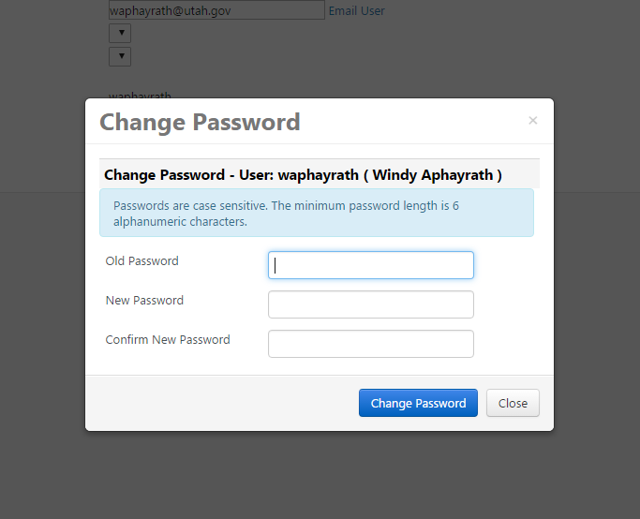
CHANGING YOUR PASSWORD
Step 4: Type in your old password which is password then enter your new password twice.

Slide 5
SECURITY QUESTION AND ANSWER
Step 5: Click on Change Security Question or Answer. There are several questions in the drop down box you can select from. Ensure your Answer and Confirm Answer match. **Setting this up will allow you to reset your own password if you happen to forget it.

Slide 6
SET MY HOME PAGE
Step 6: Go back up to your name in the top right and select Set My Home Page

Slide 7
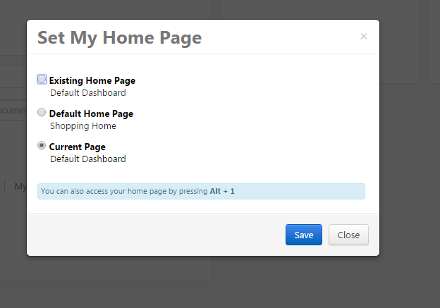
SET MY HOME PAGE
Step 7: Select the Option that says “Default Dashboard”

Slide 8
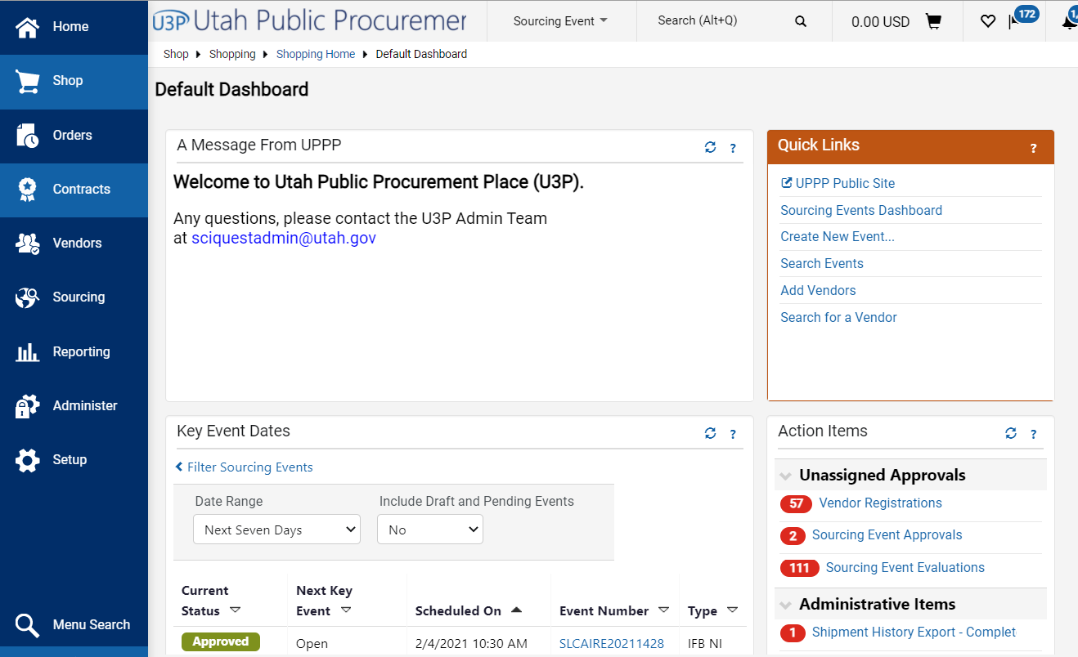
DEFAULT DASHBOARD NAVIGATION
Step 8: Select the Option that says “Default Dashboard”
This is where you will see and navigate yours and your entity’s sourcing events

