Slide 1
State Cooperative Contract Sales Reporting Guide

Slide 2
The Requirement
A quarterly submission usage report is required to be submitted for all contracts. This is still required even if the quarter has no usage. All reports submitted are to coincide with the quarters and date ranges as outlined below.
Reporting Period 1: January 1 - March 31 (due by April 30)
Reporting Period 2: April 1 - June 30 (due by July 31)
Reporting Period 3: July 1 - September 30 (due by October 31)
Reporting Period 4: October 1 - December 31 (due by January 31)

Slide 3
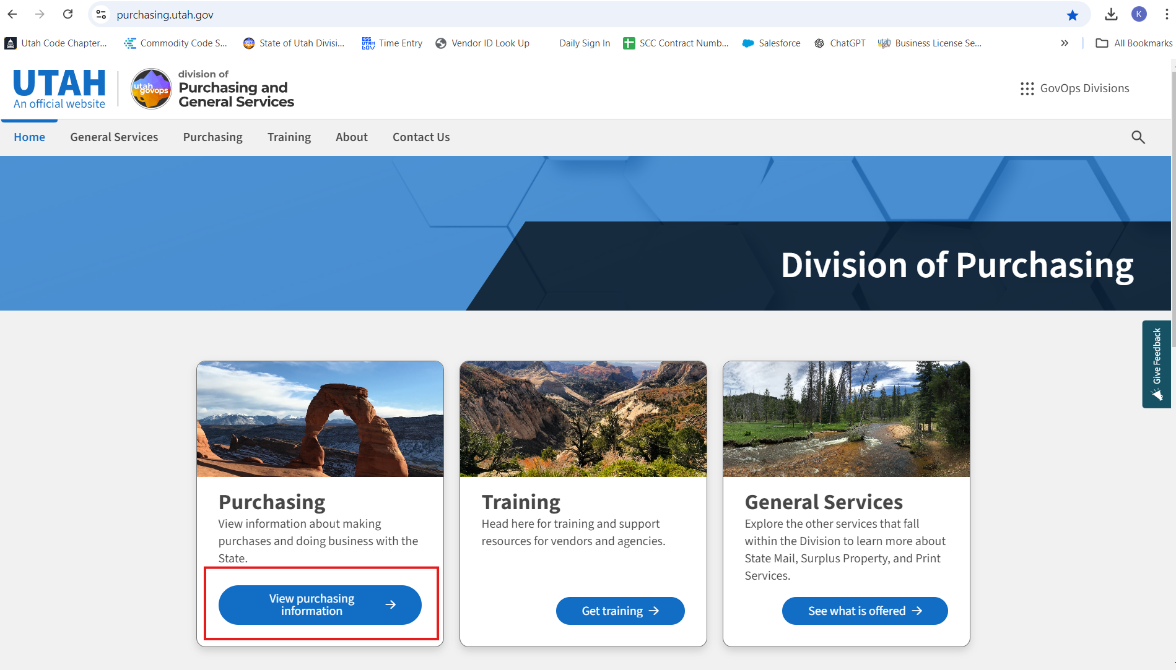
Go to purchasing.Utah.gov and select “View Purchasing Information”

Slide 4
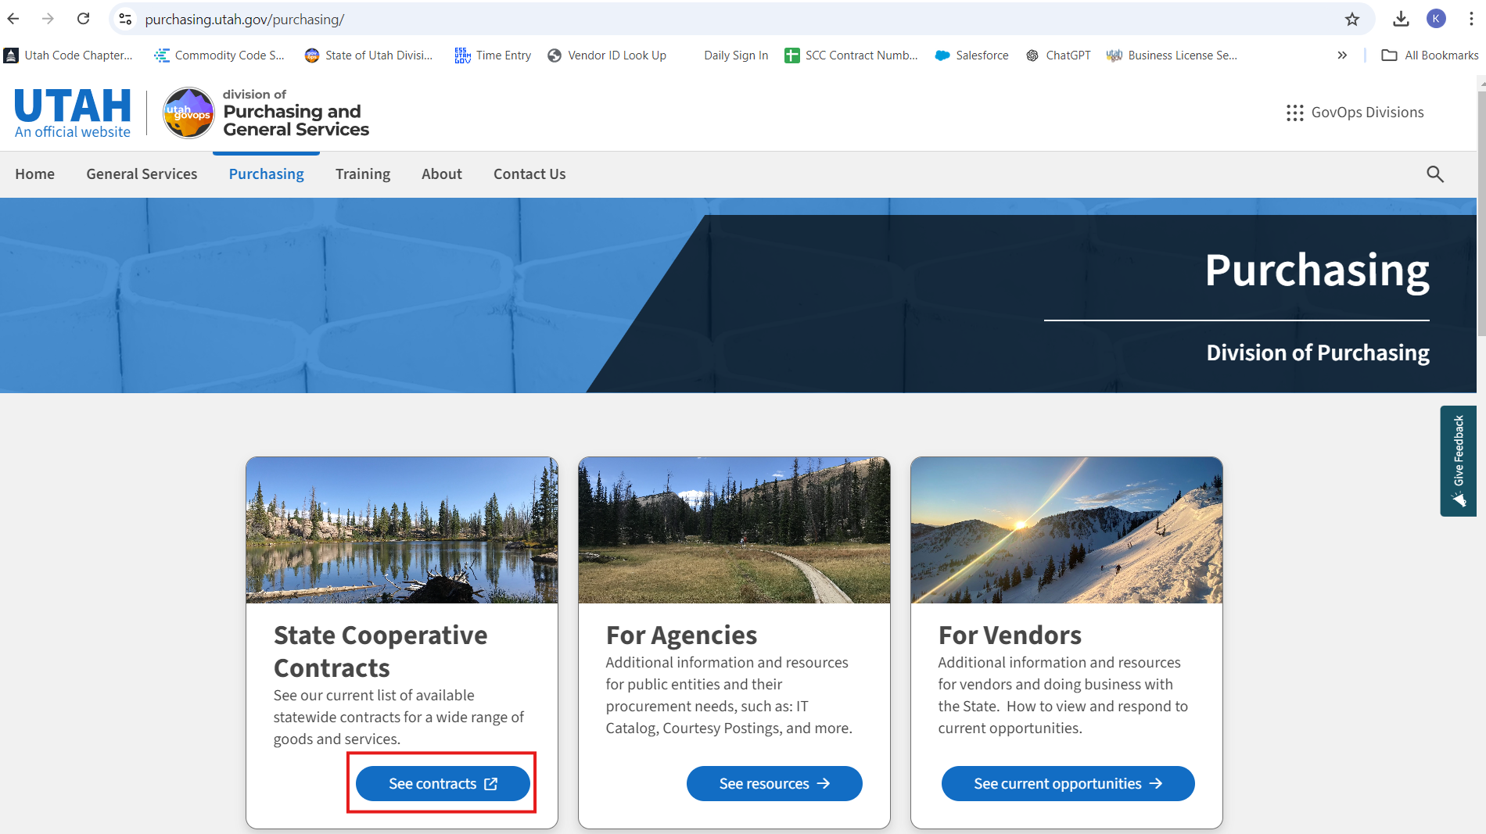
Select State Cooperative Contracts “See Contracts”

Slide 5
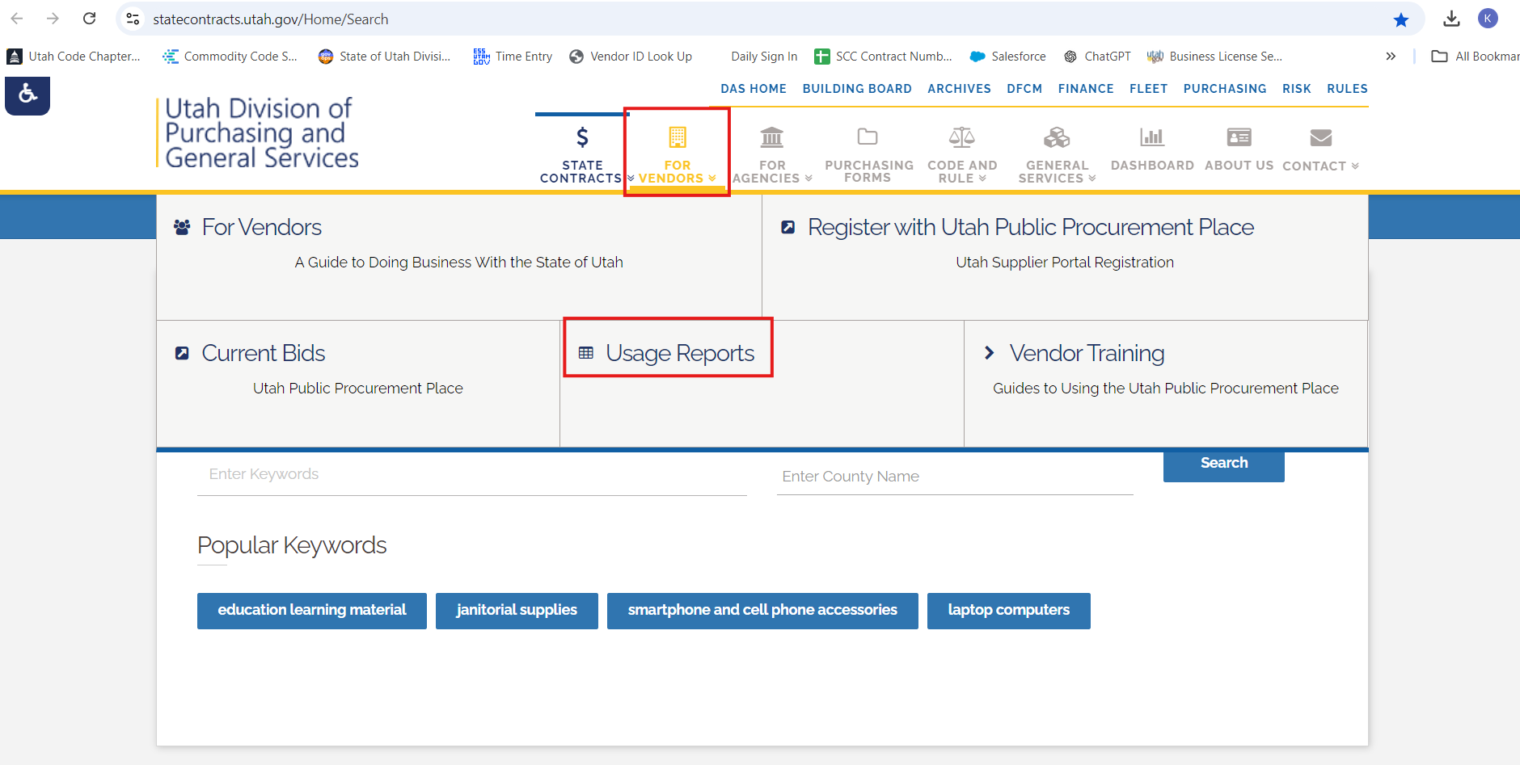
On the top menu hover over “For Vendors” and then select Usage Reports”

Slide 6
Under the heading “Sales and Usage Reports for Current State Cooperative Contractors” click the link for “Download the Usage Report Template”. Fill out the template. It is a best practice to download the template each quarter. Using older saved versions may cause issues when you are trying to upload.

Slide 7
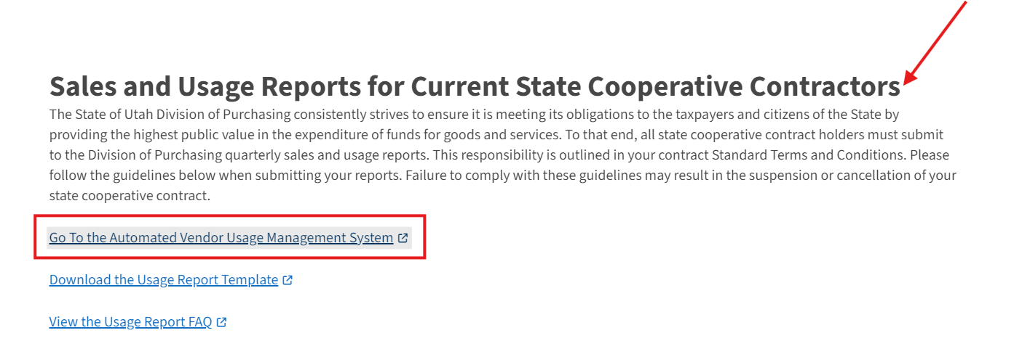
Under the same heading, select the link titled “Go to Automated Vendor Usage Management System”. You will want to make sure you are using Google Chrome or Mozilla Firefox as your browser.

Slide 8
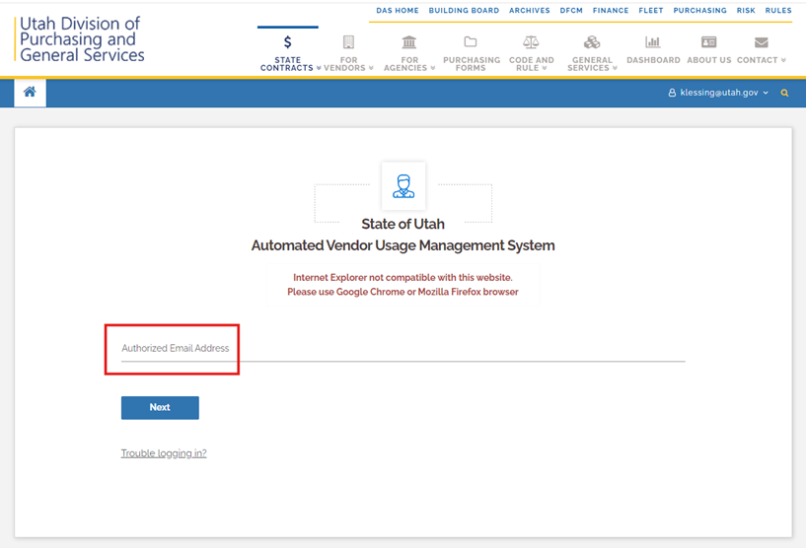
Enter in your email address. If your email doesn’t exist in the database email your contract manager and ask that your email be added to upload usage reports. You can also click the “Trouble logging in?” link.

Slide 9
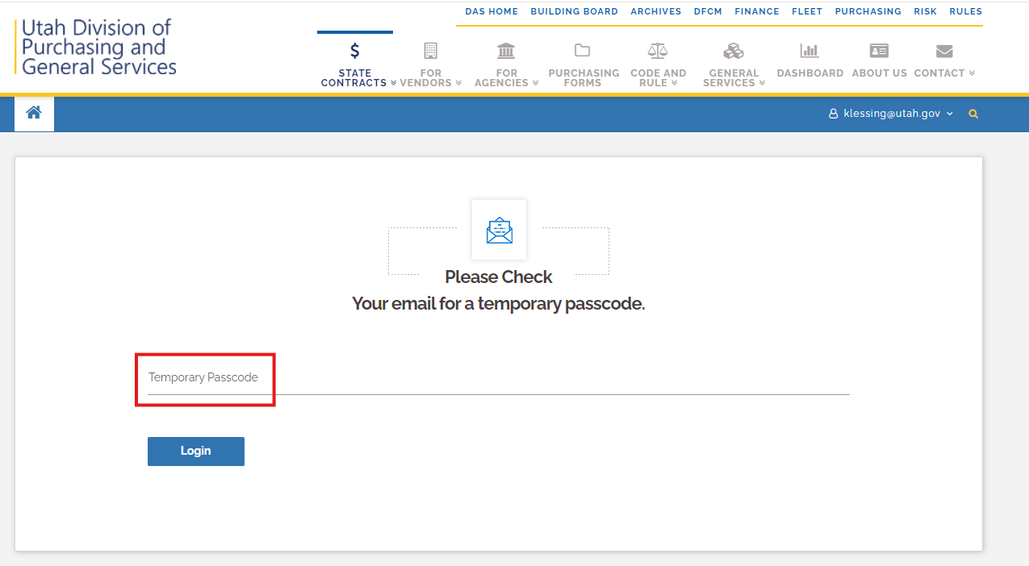
Enter in your temporary password. The temporary password is emailed to you each time you log in.

Slide 10
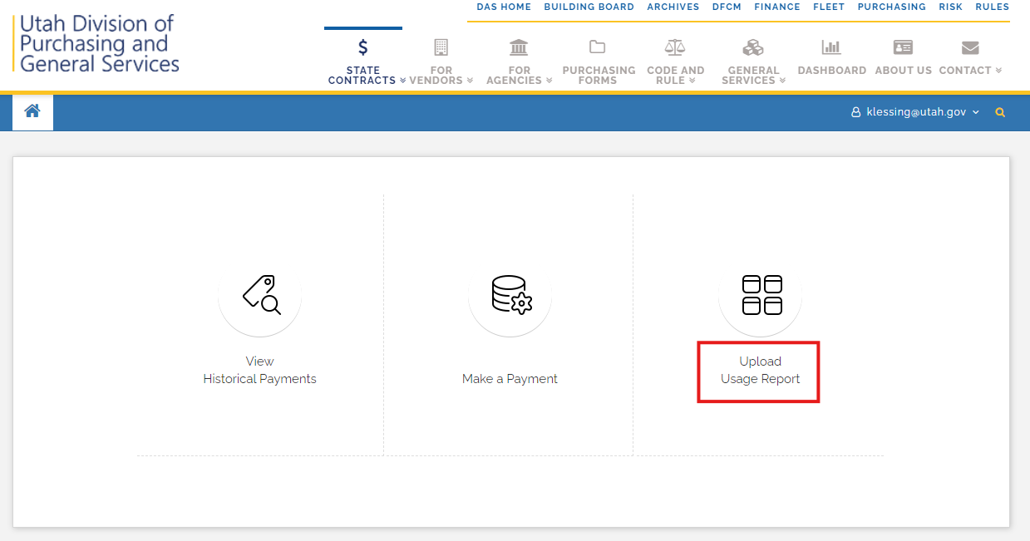
Click on “Upload Usage Report”

Slide 11
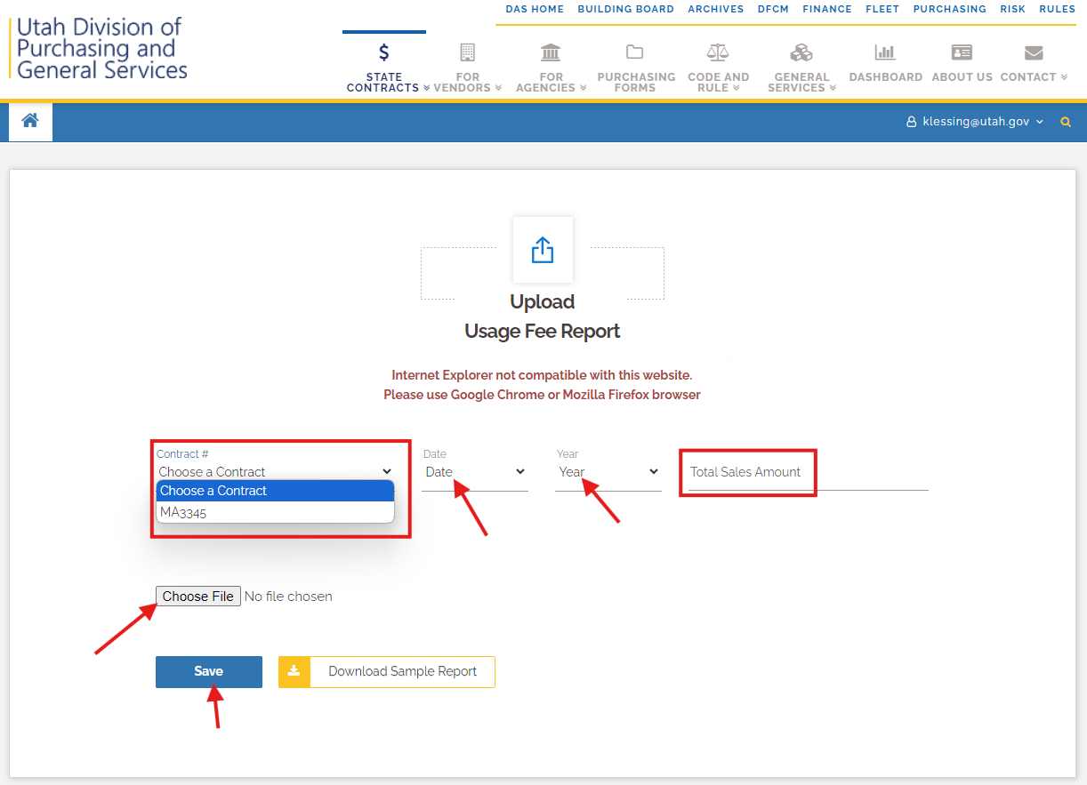
Select your contract number. Choose the date and year that corresponds with the usage report. Enter in the total sales amount. Choose your usage report and save.

Slide 12
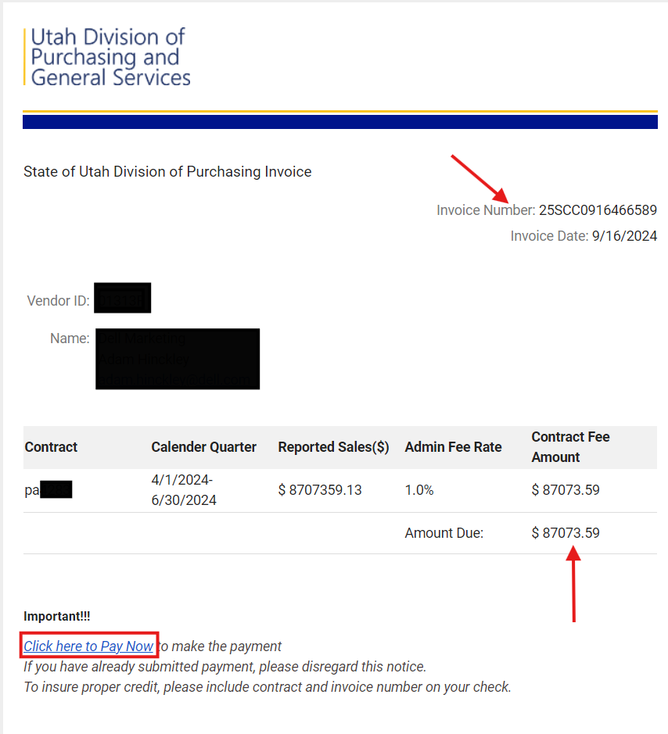
Once your usage is uploaded, you will receive an email. The email is your invoice. It shows your invoice number, the amount due and provides a link for you to pay the invoice.

