Slide 1
Vendor guide: vendor question and answer board
updated 08/30/2019

Slide 2
Vendor question & answer board
The Question and Answer Board is an opportunity for vendors to ask written questions to the State on a publicly released solicitation (i.e., IFB, Sole Source, RFP, RFSQ, RFI, etc.), and for the State to provide publicly written answers to the vendor questions.
The length of the Q&A period is provided within the published solicitation and is set by the public entity who released the posting.
A public entity is not required to provide a Q&A Period. Nonetheless, if a Q&A period is provided, it may range from 1 to 30+ days, depending on the duration set by the releasing entity.
The information provided in this guide is for training purposes only. It does not preclude a public entity from structuring its question and answer period / board differently from what is represented herein.

Slide 3
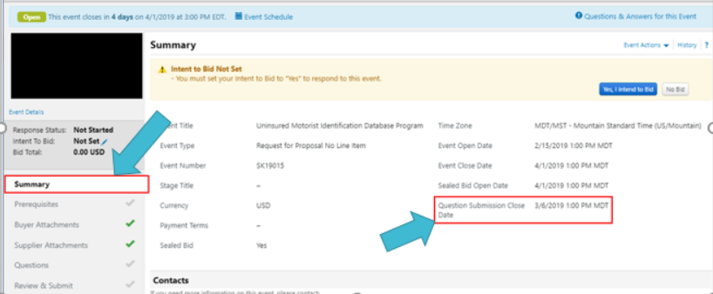
Duration of the question and answer period
To view the duration of the Q&A board navigate to the posted sourcing event.
Select the Summary section. Therein you will see Question Submission Close Date which provides the deadline for vendors to submit written questions to the state.

Slide 4
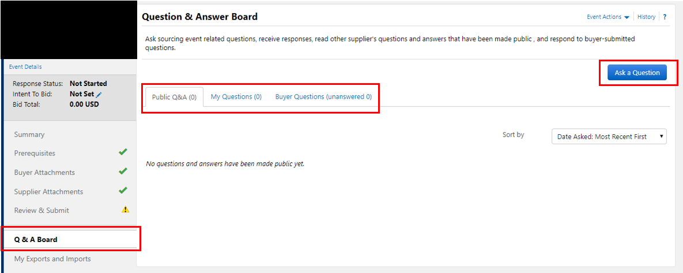
Submitting a question to the Q&A board
To submit a question to the Q&A board select the Q & A Board section.
Select Ask a Question*
*NOTE – You will only see the option to Ask a Question if the Q&A board is still open. If the Q&A period is closed you will not see the option to Ask a Question.

Slide 5
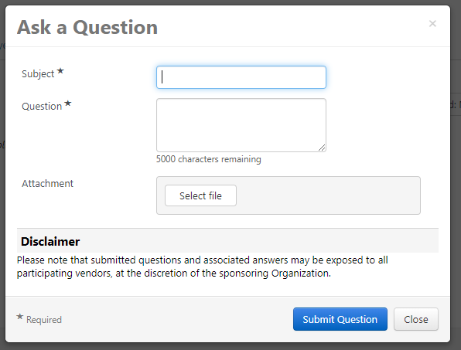
Submitting a question to the Q&A board
After selecting Ask a Question you will receive the screen below where you can ask your question. When finished, select Submit Question.

Slide 6
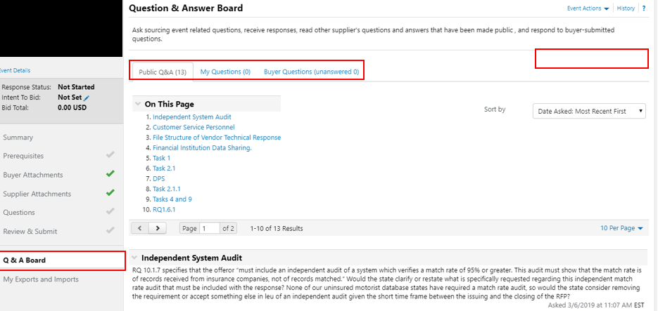
Submitting a question to the Q&A board
In the illustrated example below you can see there is no option to Ask a Question, signifying the Q&A period has closed.

Slide 7
Viewing questions and answers on the Q&A board
To view all questions and answers posted on the Q&A board select the Q & A Board section.
Select the Public Q&A tab.
Within the illustrated example you can see there are 13 vendor questions that are answered. Scrolling throughout the page you can see what those questions and answers are.

Slide 8
Questions?
JAGGAER SUPPLIER SUPPORT – 1-800-233-1121 OPTION 2
OR
UTAH PUBLIC PROCUREMENT PLACE (U3P) ADMIN TEAM –
SCIQUESTADMIN@UTAH.GOV

