Slide 1
USING THE SOLICITATION TEMPLATE
UPDATED FEBRUARY 3, 2021

Slide 2
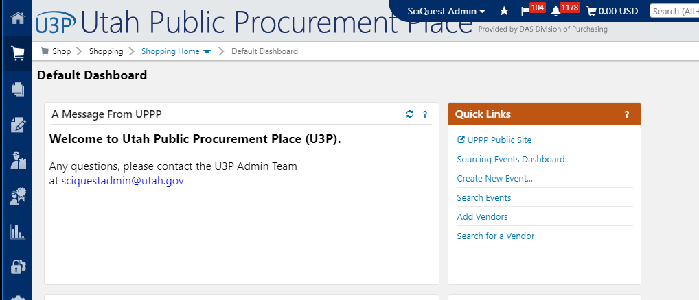
Create a New Event

Slide 3
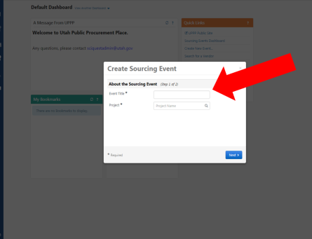
Step 2
Title your event based on your procurement: this should not be your bid #
Project or Work Group – this will generally auto-populate with the name of your agency
If it does not, click on the magnifying glass

Slide 4
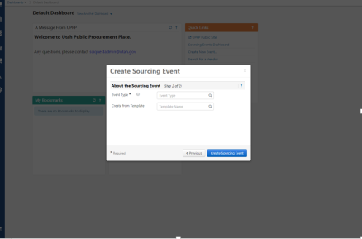
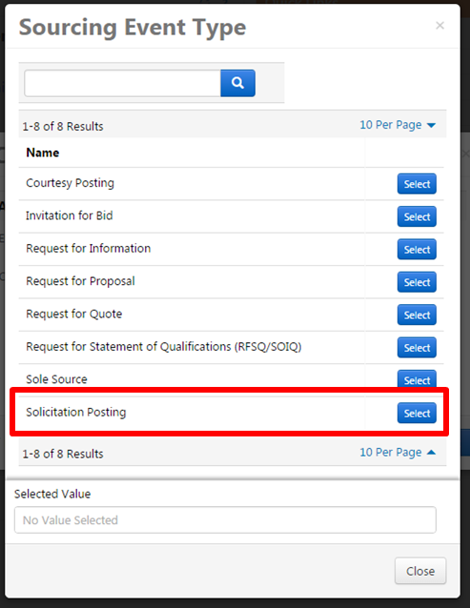
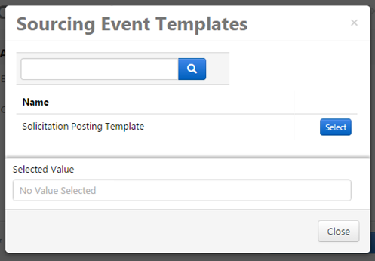

Slide 5
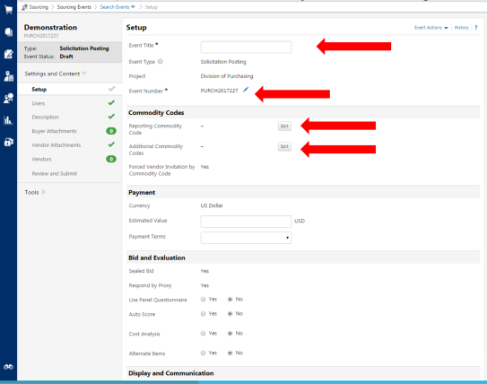
Step 3
Continue to create your event by putting the requisite information…

Slide 6
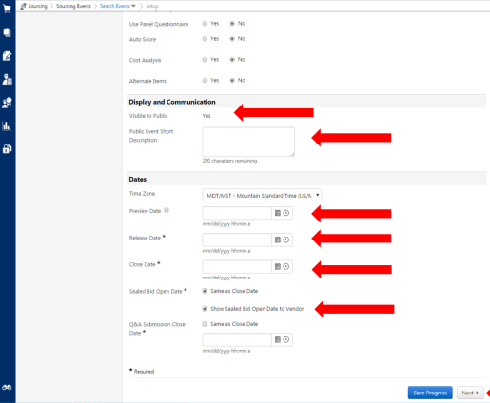
Step 4
Continue to create your event by putting the requisite information…

Slide 7
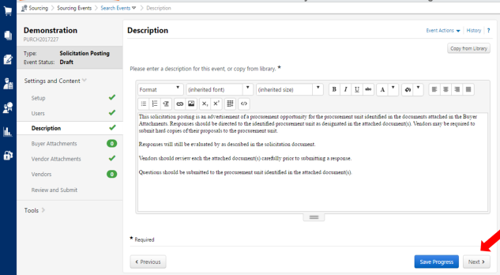
Step 5
Add information to the description field.

Slide 8
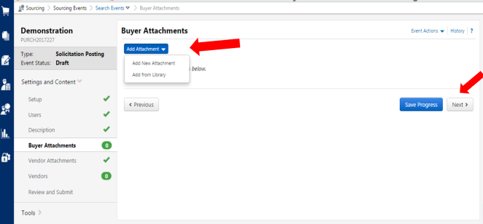
Step 6
Add any documents you have to the Buyers Attachments section

Slide 9
Vendors will be automatically added to the event based on the commodity codes that you pick.
If the vendor is registered for the codes you pick they will get a notification.
If you want to add vendors specifically you can do that by following the next steps.

Slide 10
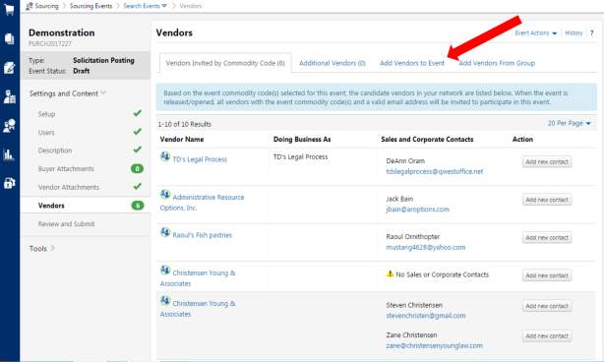
Step 7

Slide 11
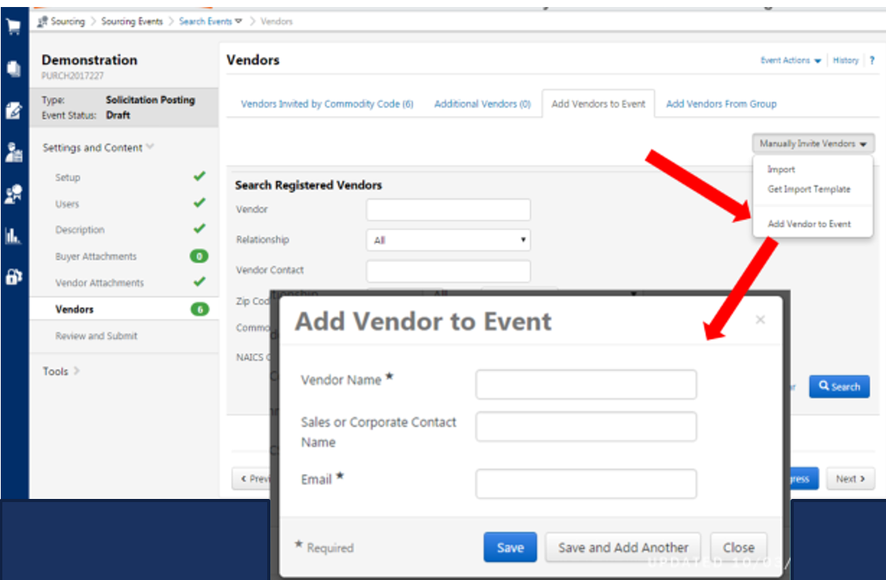
Step 8
Then manually invite vendors to the event.

Slide 12
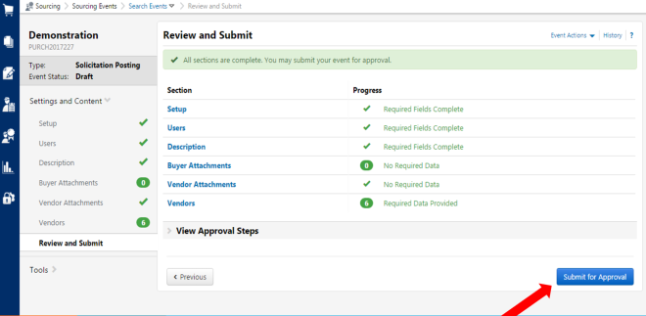
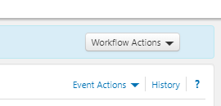
Step 9
The last step is to “Review and Submit”.
Once you “Submit for Approval” you will need to “Approve” the event using the Workflow Actions button.
Once you have done that the event will be public.

